Slide 1
DIRECTIONS Read the following information carefully and answer the questions given below it.
Six friends P, Q, R,S, T and U are members of a club and play a different game of - Football, Cricket, Tennis, Basketball, Badminton and Volleyball.
(ii) T, who is taller than P and S, plays Tennis.
(iii) The tallest among them plays Basketball.
(iv) The shortest among them plays Volleyball.
(v) Q and S neither play Volleyball nor Basketball.
(vi) R plays Volleyball.
(vii) T is exactly between Q who plays Football and P in order of height. TCS NQT 2020
Who will be at the third place if they are arranged in descending order of their height ?
R T Q Not
Who among them plays Basketball?
Q T P U

Slide 2
A lady runs 12 km towards north. Then 6 km towards south and 8 km towards east. How for is she from her starting point and in which direction?
(1) NE – 20 km (2) NE – 15 km (3) NW – 10 km (4) NE – 10 km (5) None of the above

Slide 3
Directions : Study the information carefully and answer the questions given below.
Point P is 10m west of point Q. Point X is 8m east of point M. Point Z is 10m north of point M. Point X is 5m south of point Q. Point B is 3m east of point Z.
Q. What is the shortest distance between point P to X?
8m 5√5m 10m √13m None of these
Q In which direction point M with respect to point B?
Southeast Northeast Southwest
Northwest None of these

Slide 4
Rajesh walked 8 km towards south-west direction. He turned to east direction and walked 20 km. Then he turned to north-east direction and walked 8km and after to west direction for 6km.Then he turned to north east direction and walked 2 km straight after he turned west direction and walked 4km.Once more he turned south-west and walked 2km.How far is he from the starting point?
(a)12km (b)10km (c)8km (d)6km (e)none of these

Slide 5
K is brother of T. M is mother of K. W is brother of M. how is W related to T?
1) Maternal Uncle 2) Paternal Uncle 3) Grandfather
4) Data Inadequate 5) None of these

Slide 6
Which of the following is true for the given expression,
if
Q+R’ means ‘Q is father of R
Q ÷ R’ means ‘R is brother of Q
Q × R’ means ‘Q is husband of R
Q – R’ means ‘Q is sister of R
‘J + K – L + N ÷ M’
K is aunt of N and M
K is father of M
N is sister of M
J is father of N
None of these

Slide 7
Directions : Read the following information carefully and answer the questions given below
P/Q means P is father of Q
P+Q means P is the mother of Q
P-Q means P is the brother of Q
P*Q means P is the sister of Q
Which of the following shows that A is aunt of E?
1 .A/B*C+D-E
2. A-B-C*D/E
3. A-B+C/D*E
4. A*B/C*D-E

Slide 8
Q1. How is P related with Z?
(a) Brother (b) Daughter
(c) Nephew (d) Niece (e) None of these
Q2. How is C related with Y?
(a) Aunt (b) Daughter in law
(c) Uncle (d) Granddaughter (e) none of these
Q3. How many male members are there in the family?
(a) Four (b) Three
(c) Five (d) Two (e) None of these
Directions : Study the following information carefully and answer the given questions:
In a family there are eight members. A is mother of B, who is brother of C. C and Q are siblings. Y is daughter of P. Z is brother in law of B, who is son of D. A has only one son. There are only two married couples in the family. P is married to B.

Slide 9
SET 01
Five plays A, B, C, D and E were organised in a week from Monday to Saturday with one play each day and No play was organised on one of these days.
Play D was organised before Thursday but after Monday.
Play E was organised on Saturday.
Play C was Not organised on the first day.
Play B was organised on the next day on which Play C was organized.
Play A was organised on Tuesday.
Which play was organised on Wednesday?

Slide 10
Ashok started walking towards South. After walking 50 m he took a right turn and walked 30 m. He then took a right turn and walked 100 m. He again took a right turn and walked 30 m and stopped. How far and in which direction was he from the starting point?
(a) 50 m South (b) 150 m North (c) 180 m East (d) 50 m North (e) None of these

Slide 11
Seven persons A, B, C, D, E, F and G are sitting in a straight line (not necessarily in the same order) facing north.
(a) Only two persons sit between F and G who sits second to the left of B.
(b) D sits third to the left of C.
(c) E sits exactly between G and B and B sits at the extreme right end of the row.
Question 1: Who amongst the f
Following sits at the extreme left of the line?
(a) F (b) D (c) C (d) E (e) G
Question 2: Four of the following five are alike in a certain way based on their seating positions in the above arrangement and so form a group. Which is the one that does not belong to that group?
(a) AG (b) CE (c) DA (d) AF (e) GB

Slide 12
QUES-A ,B, C, D and E are five men sitting in a line facing to south - while M, N, O, P and Q are five ladies sitting in a second line parallel to the first line and are facing to North.
B who is just next to the left of D, is opposite to Q.
C and N are diagonally opposite to each other.
E is opposite to O who is just next right of M.
P who is just to the left of Q, is opposite to D.
M is at one end of the line.
1.Who is sitting third to the right of O ?
A. Q B. N C. M D. P E. Data inadequate
2. If B shifts to the place of E, E shifts to the place of Q, and Q shifts to the place of B, then who will be the second to the left of the person opposite to O ?
A. Q B. P C. E D. D E. N

Slide 13
. How is ‘go’ written in a code language?
I. ‘now or never again’ is written as ‘to ka na sa’ in that code language.
II. ‘you come again now’ is written as ‘ja ka ta sa’ in that code language.
III. ‘again go now or never’ is written as ‘na ho ka sa to’ in that code language.
(a) Only I and III are sufficient to answer the question.
(b) Only II and III are sufficient to answer the question.
(c) Only I and II are sufficient to answer the question.
(d) All I, II and III are required to answer the question.
(e) None of these

Slide 14
. How is the word ‘plant’ written in the given code language?
I. ‘Buy a new plant today’ is written as ‘4 $ % 7 2’ and ‘not the plant she said’ is written as ‘@ # 5 $ 9’.
II. ‘Plant is always good’ is written as ‘> 6 3 $’ and ‘is good buy always’ is written as ‘3 > 2 6’.
(a) The data in statement I alone are sufficient to answer the question, while the data in statement II alone are not sufficient to answer the question
(b) The data in statement II alone are sufficient to answer the question, while the data in statement I alone are not sufficient to answer the question
(c) The data in both statements I and II together are necessary to answer the question
(d) The data even in both statements I and II together are not sufficient to answer the question
(e) The data either in statement I alone or statement II alone are sufficient to answer the question

Slide 15

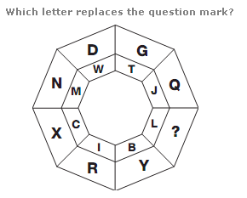

Slide 16
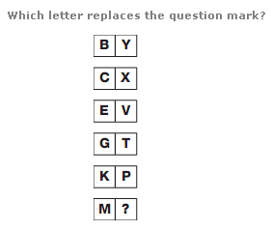

Slide 17
Q14. Statements: F ≥ M, M> A, R< A, E > R
Conclusions: I. M> E
II. F ≥ E
III. F< E
(a) Only I follows
(b) Only I & II follow
(c) Only II and III follow
(d) either II or III follows
(e) All follow

Slide 18
Q15. Statements: A ≥ B, M >B, D< M, F =D
Conclusions: I. B > D
II. B < A
III. M> F
(a) All follow
(b) Only I & II follow
(c) Only II and III follow
(d) Only either II or III follows
(e) Only III follows

Slide 19
WARM UP ZERO SET :
In a seven-storied building, having floors numbered 1 to 7, A, B, C, D, E, and F each live on a different floor. The ground floor is numbered floor number 1, the floor above it floor number 2 and so on. One of the floors in the building is vacant.
Conditional statements
A lives on the fifth floor.
No floor below the fifth floor is vacant; and no odd numbered floor is vacant.
Only D lives between E and F.
E does not live in an odd-numbered floor.
E does not live on a floor immediately above or immediately below C's floor.
B does not live on the bottom-most floor.

Slide 20
. In a certain code, MONKEY is written as XDJMNL. How is TIGER written in that code ?
A. QDFHS
B. SDFHS
C. SHFDQ
D. UJHFS

Slide 21
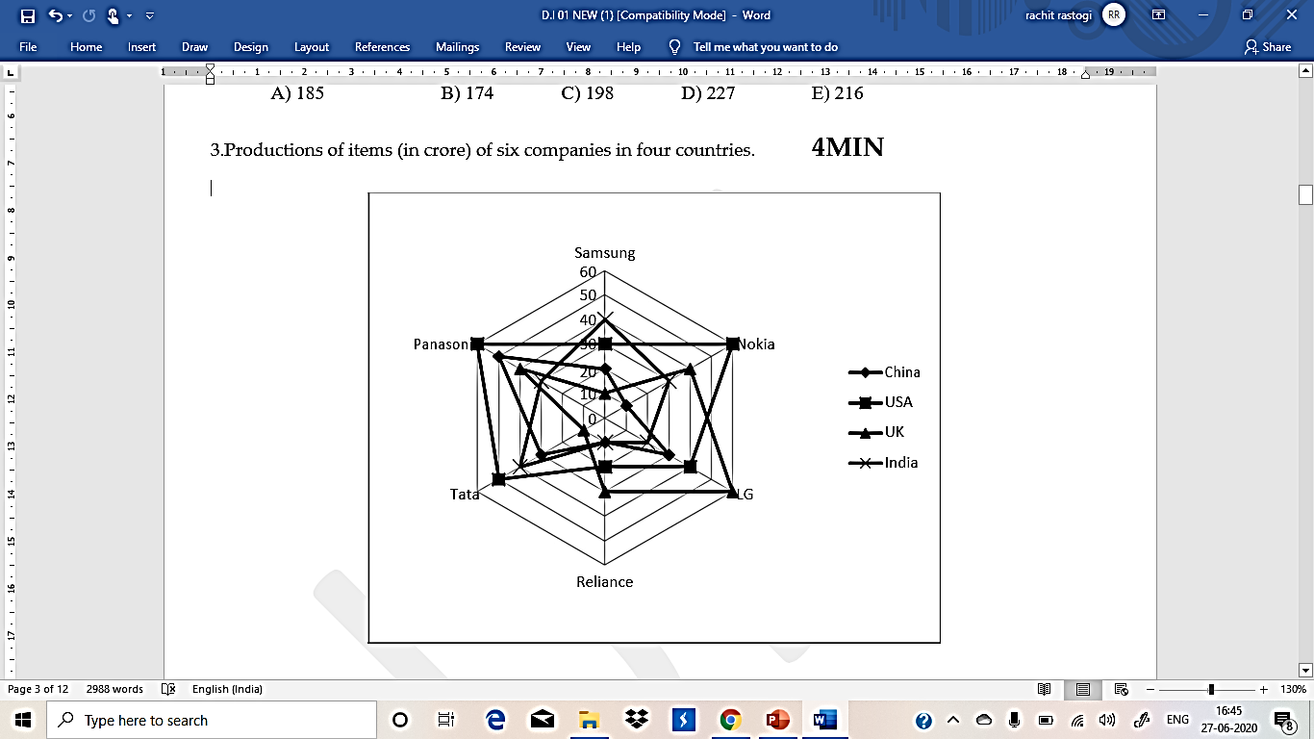
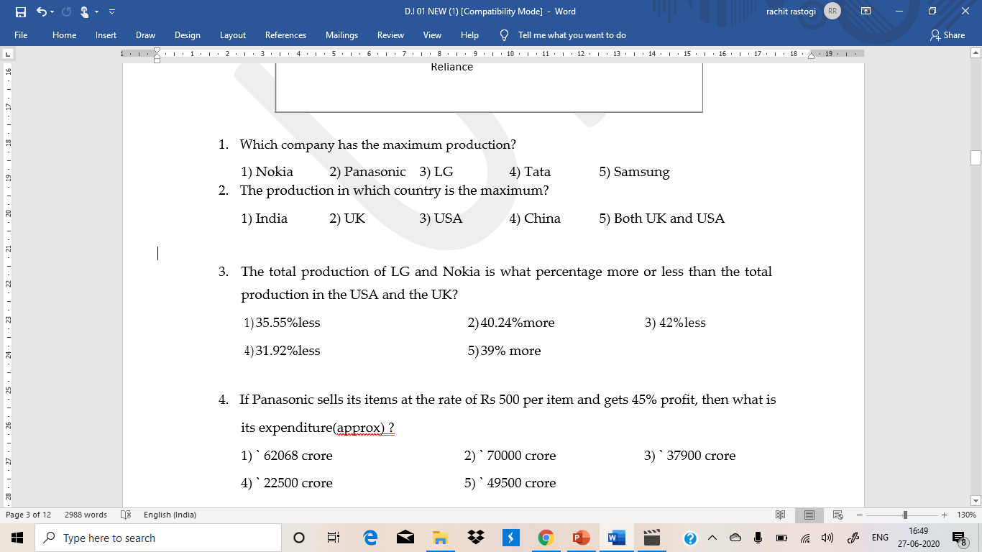

Slide 22
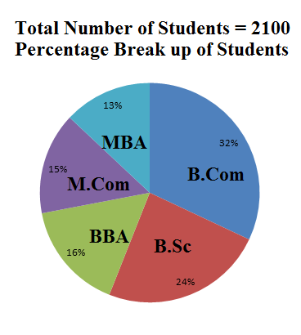
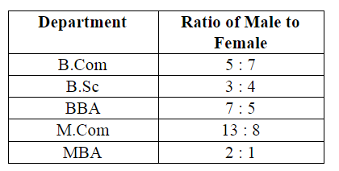
What is the respective ratio of the number of Female Student studing in BBA and the total number of Students in that department?
A) 7:11 B) 11:7 C) 12:5 D) 5:12 E) None

Slide 23
What is the respective ratio of the number of female student studying in B.Sc to the the number of female student studying in B.Com?
A) 35:27 B) 14:23 C) 27:35 D) 21:16 E) None

Slide 24
The number of male student studying in MBA is what per cent of the total number of Students studing in that department?
A) 32% B) 25% C) 66 2/3% D) 33 1/3% E) None

Slide 25
Directions (1 - 5): Study the information carefully and answer the questions that follow
In a school having 400 students, boys and girls are in the ratio of 3:5. The students speak Hindi,
English or both the language. 12% of the boys speak only Hindi. 22% of the girls speak only
English. 24% of the total students speak only Hindi and the number of boys speaking both the
languages is six times the number of boys speaking only Hindi.

Slide 26
1. How many boys speak Hindi?
1) 18 2) 126 3) 108 4) 26 5) None of these
2. How many girls speak only Hindi?
1) 55 2) 117 3) 96 4) 78 5) None of these
3. How many students speak English?
1) 304 2) 79 3) 225 4) 117 5) None of these
4. The number of girls speaking only Hindi is what per cent of the total number of students
speaking only Hindi?
1) 38.2% 2) 71.8% 3) 31.2% 4) 78% 5) None of these
5. What is the ratio of the number of boys to the number of girls speaking both the languages?
1) 23:25 2) 12:25 3) 12:13 4) 25:13 5) None of these

Slide 27
All rivers are water.
Some water is pond.
No pond is tree.
All trees are jungle.
Conclusion:
Some rivers are pond.
Some water is not tree.
All rivers being jungle is a possibility.
Options
Only I. Only III. II and III. I and II. None follows

Slide 28
. Statements: All green are pink. Some pink are black.
Some black are blue. All blue are white.
Conclusions: I. Some black are white.
II. Some blue are pink.
III. Some pink are green.
IV. No green is white.
(1) None follows (2) Only I and III follows (3) Only III follows (4) Only either I or II follows (5) None of these

Slide 29
Conclusion: Some pens are sharpener; No eraser is a pen.
Statement 1: Some pens are erasers. All erasers are sharpeners.
Statement 2: No pen is an eraser, some erasers are sharpeners.
Statement 3: Some sharpeners are erasers. All pens are erasers.
Statement 4: All sharpeners are pen. No pen is an eraser.
Statement 5: Some sharpeners are definitely erasers. No pen is a sharpener.
Mark your answer as
A. Only Statement 1 follows
B. Only Statement 2 follows
C. Only Statement 3 follows
D. Only Statement 4 follows
E. Only Statement 5 follows

